Slide 1
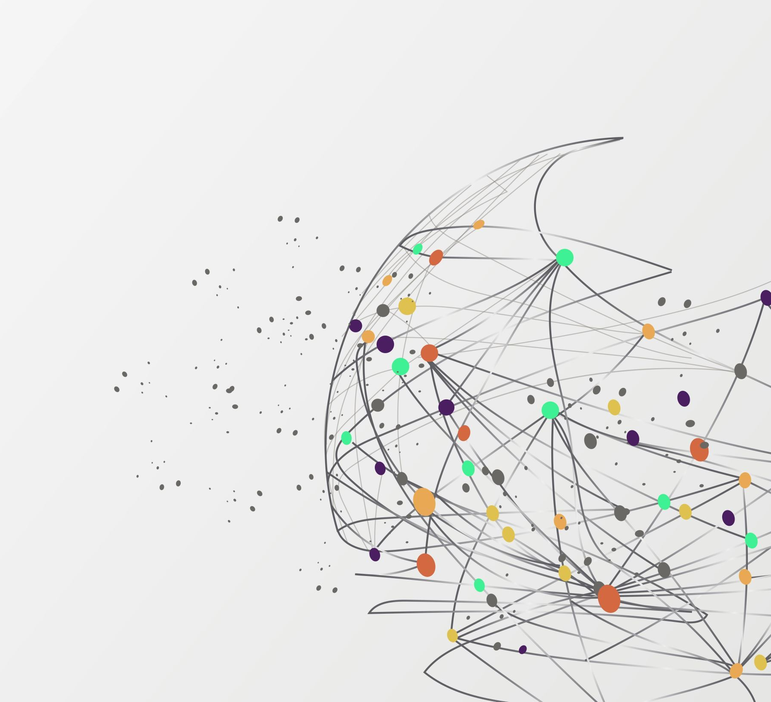
Acoustic Sensor Arrays in 3D Printing
Mekhi Connor
Malik Lewis

Slide 2
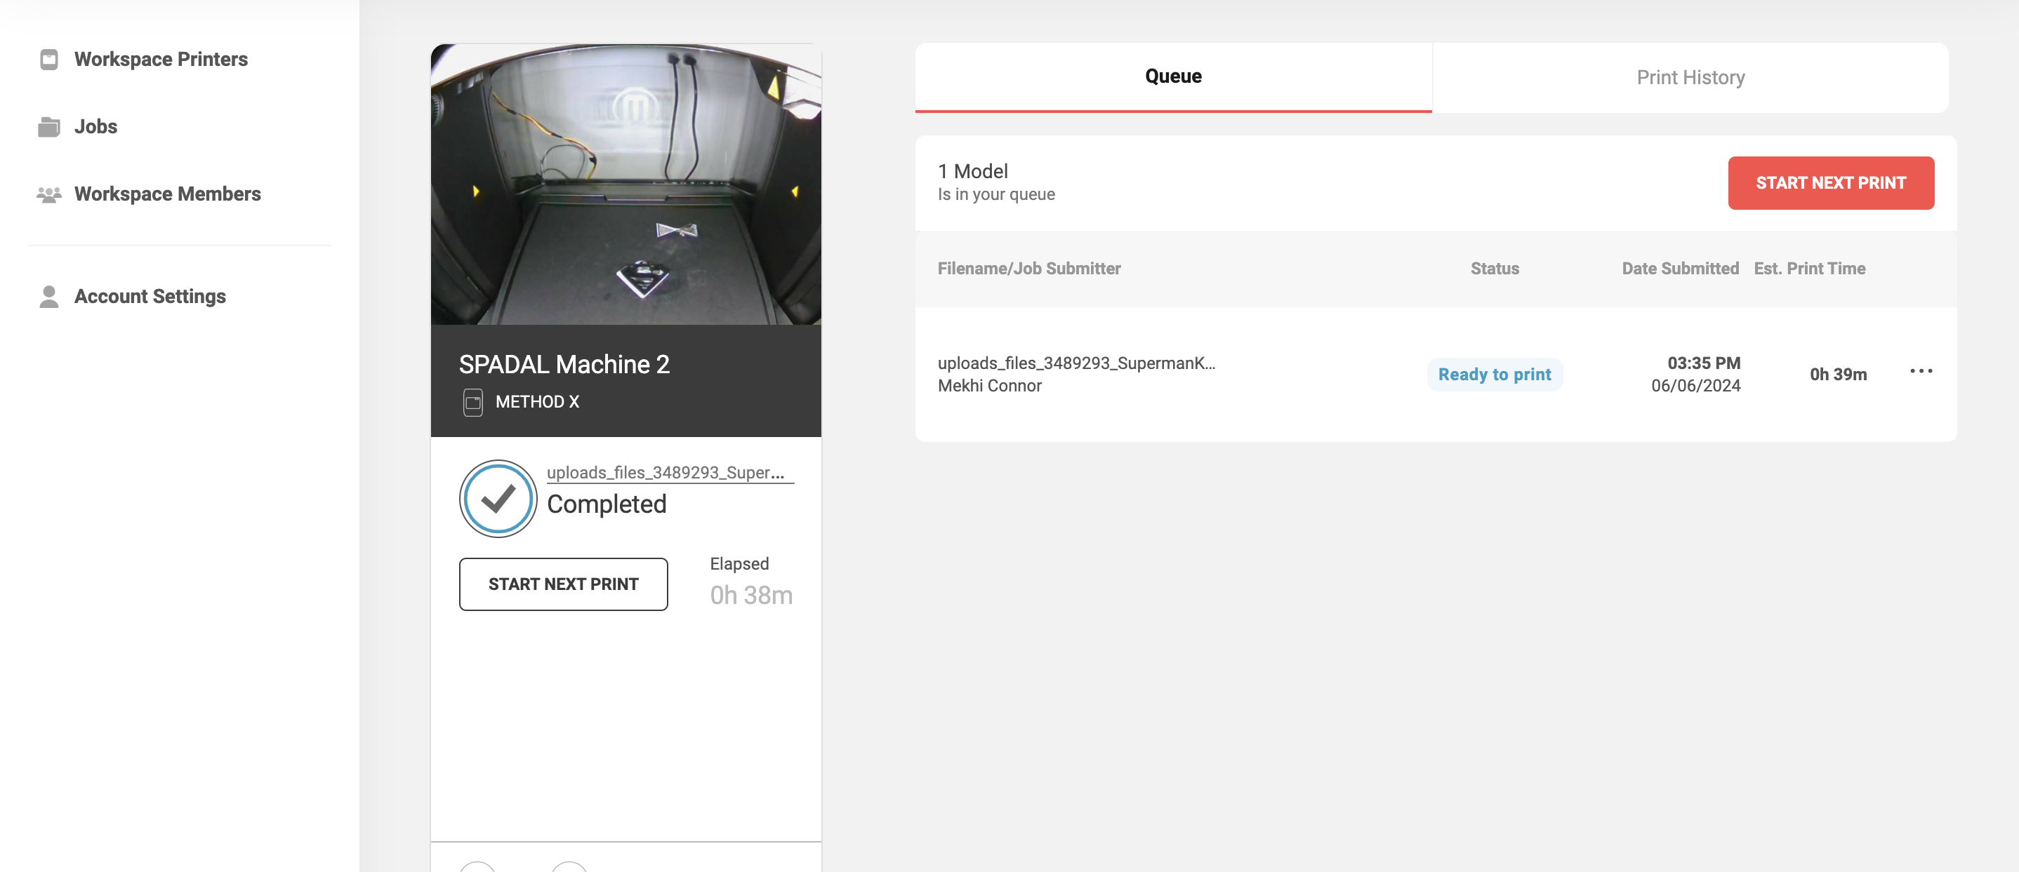
Cloud Printing
A technology developed by Google in 2010 that allowed you print to documents and photos from anywhere using any device, and you could print document through any computer. The software worked by allowing you to connect your printer to the web, enabling you to print from your phone, tablet, laptop, or desktop.
Some of the key features for cloud printing
Remote Printing: Print from any device connected to the internet, regardless of the location.
Printer Sharing: Easily share printers with others.
Compatibility: It supported various devices and operating systems, including Windows, Mac, Linux, Chrome OS, Android, and iOS.
No Driver Installation: No need to install printer drivers on each device, as the service managed printer compatibility and communication.
Notes:
Yesterday,

Slide 3
Acoustic sensors
Acoustic Sensors is a technology that involves detecting, analyzing, and interpreting sound waves to gather information about the environment or a specific object. Though the sound wave that it picks up it mangaes to monitor and measure various parameters.
Different applications of acoustic sensors:
Medical Imaging: Using ultrasound waves to create images of internal body structures
Environmental Monitoring: Monitoring sounds in natural environments to study wildlife
Industrial Applications: Detecting leaks, monitoring machinery health, and ensuring the integrity of industrial equipment.
Security and Surveillance: Using acoustic sensors to detect and identify unauthorized activities or intrusions that cameras might not be able to pick up.
Acoustic sensors in 3D printing are used to monitor and enhance the printing process by detecting and analyzing sound waves generated during printing.

Slide 4
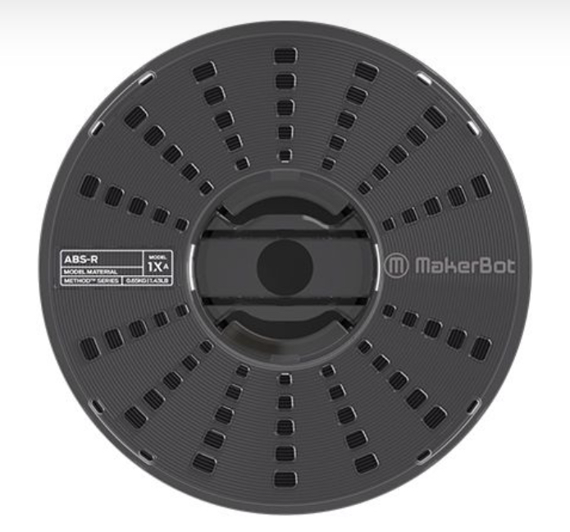
This week's technical difficulties & how we solved them
The 3D printer ran out of filament which is the material that the machine uses to print
In order to change the filament, we first had to remove the old filament tray. Once we completed that we placed the new filament tray and guided it inside the machine. Once we saw the new filament coming out of the extruder we then knew we successfully changed the filament.
ABS-R Filament

